Slide 1



AI-Powered Crowdsourced Monitoring System for Road Safety and Environmental Management
(Integrating Computer Vision, AI/ML, and Image Classification)

Slide 2

Learning Objectives
Understand how crowdsourced smartphone imagery can monitor road and environmental conditions.
Apply Computer Vision and AI/ML models for real-time detection and classification.
Develop a cloud-based system for automated data collection, analysis, and alert generation.
Learn multi-task learning, image enhancement, and predictive modeling techniques.
Demonstrate privacy-aware, scalable monitoring using publicly available devices.
GOAL

Slide 3
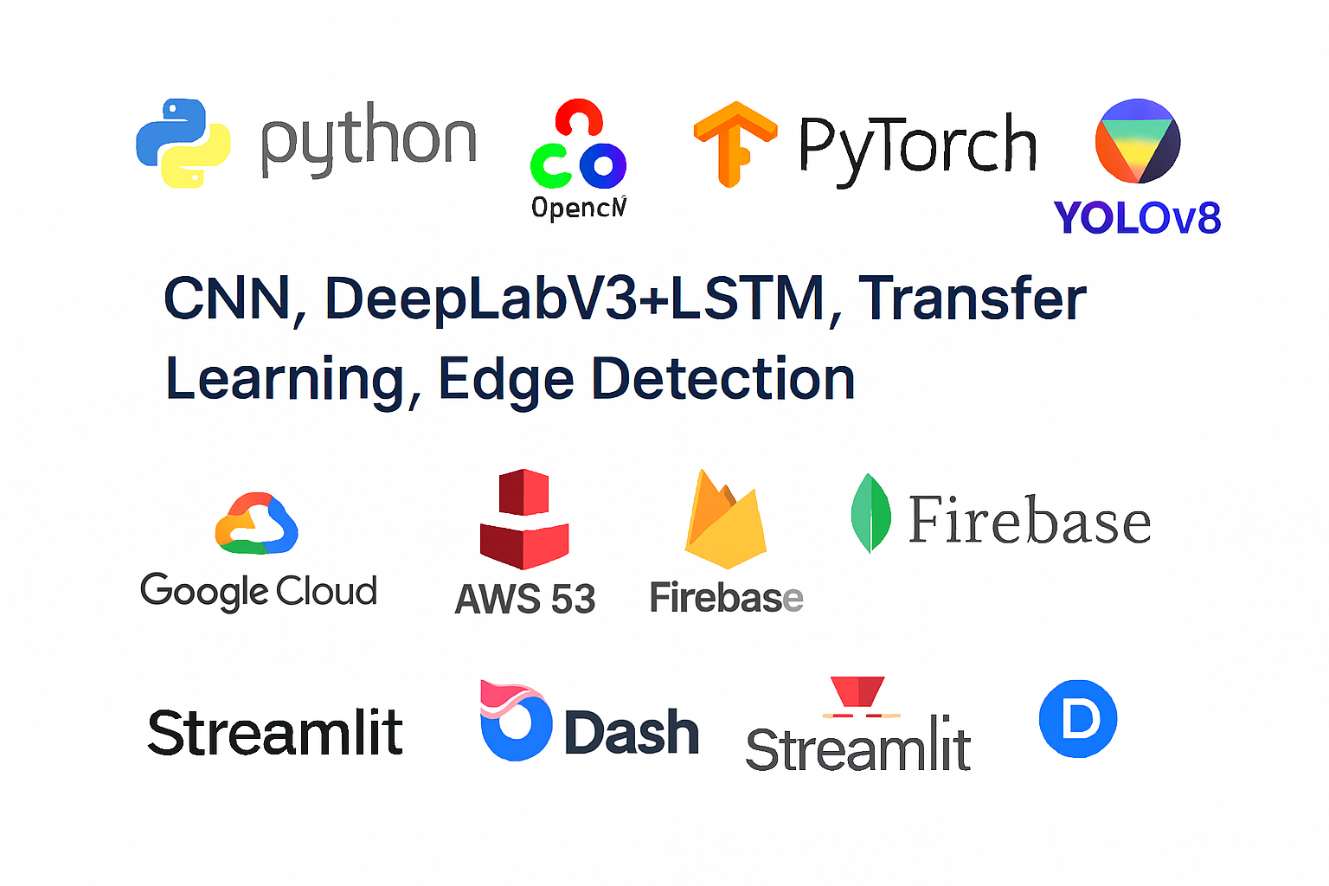
Tools and Technology used
Programming & Frameworks:
Python, OpenCV, TensorFlow, PyTorch, YOLOv8
AI/ML Techniques:
CNN, DeepLabV3+, LSTM, Transfer Learning, Edge Detection
Cloud & Data Tools:
Google Cloud / AWS S3 for image storage
MongoDB / Firebase for metadata
Streamlit or Dash for visualization
Additional Tools:
OpenStreetMap API (Geo-tagging)
Image Augmentation (Albumentations Library)

Slide 4
Methodology
Data Collection:
Smartphone extension collects geotagged road images. .
Preprocessing:
Denoising, histogram equalization, edge & perspective correction..
Feature Extraction:
CNN + segmentation models (U-Net, DeepLabV3+) analyze road regions..
Image Classification & Detection:
YOLOv8 and CNN classify potholes, litter, obstacles, and green space changes.
Predictive Analysis:
3D CNN or LSTM forecasts possible damage or hazard zones
Alert Generation:
Real-time notifications and dashboard visualization for authorities.

Slide 5
Problem Statement:
Cities face difficulty in monitoring road safety and environmental conditions due to:
Variable image quality from crowdsourced smartphones.
smartphones.
Limited area coverage and inconsistent participation.
Model inaccuracy across weather and lighting variations.
Model inaccuracy under poor lighting or heavy traffic
Environmental effects like rainfall or flooding accelerating road damage.
Absence of privacy-preserving, real-time analysis.

Slide 6
Solution:
An AI-powered crowdsourced platform that:
AI-powered crowdsourced platform combining CNN + Computer Vision.
Geotagged image ingestion for road condition detection.
Multi-task model: road hazard + environment sustainability analysis..
Predictive LSTM/3D CNN forecasting for infrastructure degradation..
Cloud-based inference with encryption and privacy..
Web dashboard visualizing hazard density and sustainability index.

Slide 7
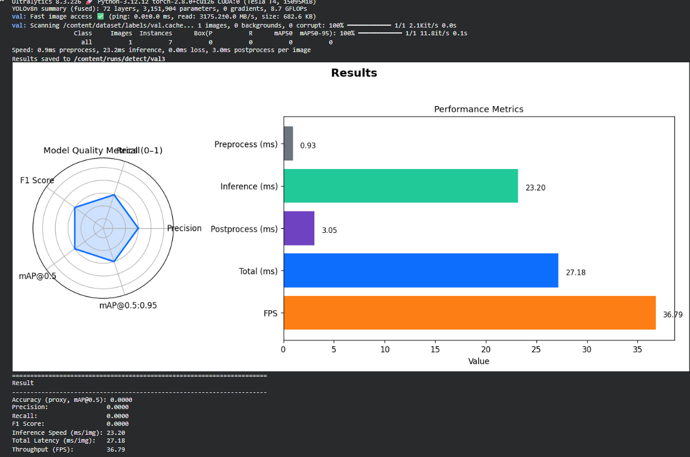
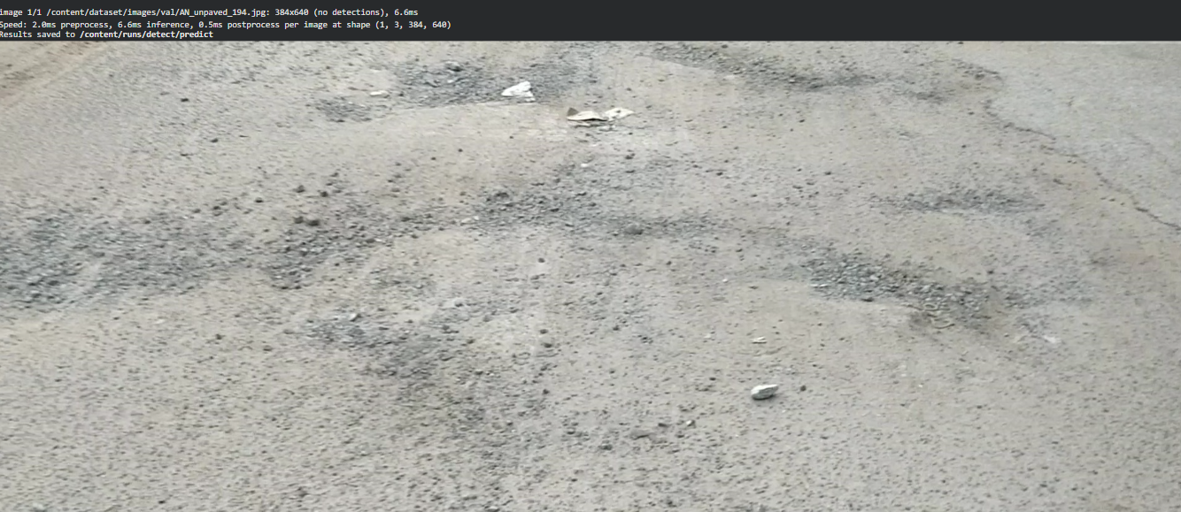
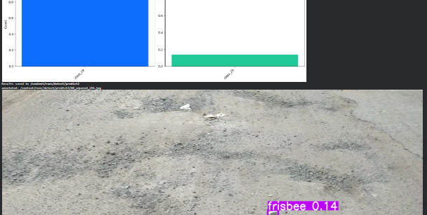
Screenshot of Output:
Output
Training Model
Testing Model

Slide 8

Conclusion:
Successfully integrates Computer Vision, Image Classification, and AI/ML into a real-time system.
Enables scalable, low-cost, and prAivacy-respecting monitoring through smartphones.
Detects and predicts road defects, dead-ends, and environmental hazards efficiently.
Provides actionable insights to urban authorities for proactive response.
A step toward sustainable, AI-driven urban management.

